Slide 1

Children vaccination INFORMATION system

Slide 2
Submitted by : Md. Atahar Ishrak Md. Zawharul Islam 18102020 17102014 Supervisor : Dr. A H M Kamal Professor of CSE Department Jatiya Kabi Kazi Nazrul Islam University, Trishal, Mymensingh, Bangladesh.

Slide 3
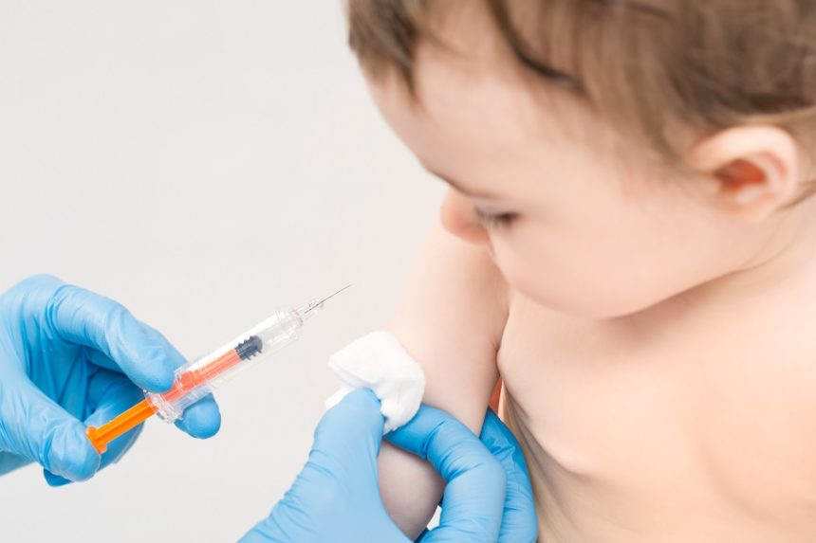
Vaccination is one of the most effective ways to prevent diseases. A vaccine helps the body’s immune system to recognize and fight pathogens like viruses or bacteria, which then keeps us safe from the diseases they cause.

Slide 4
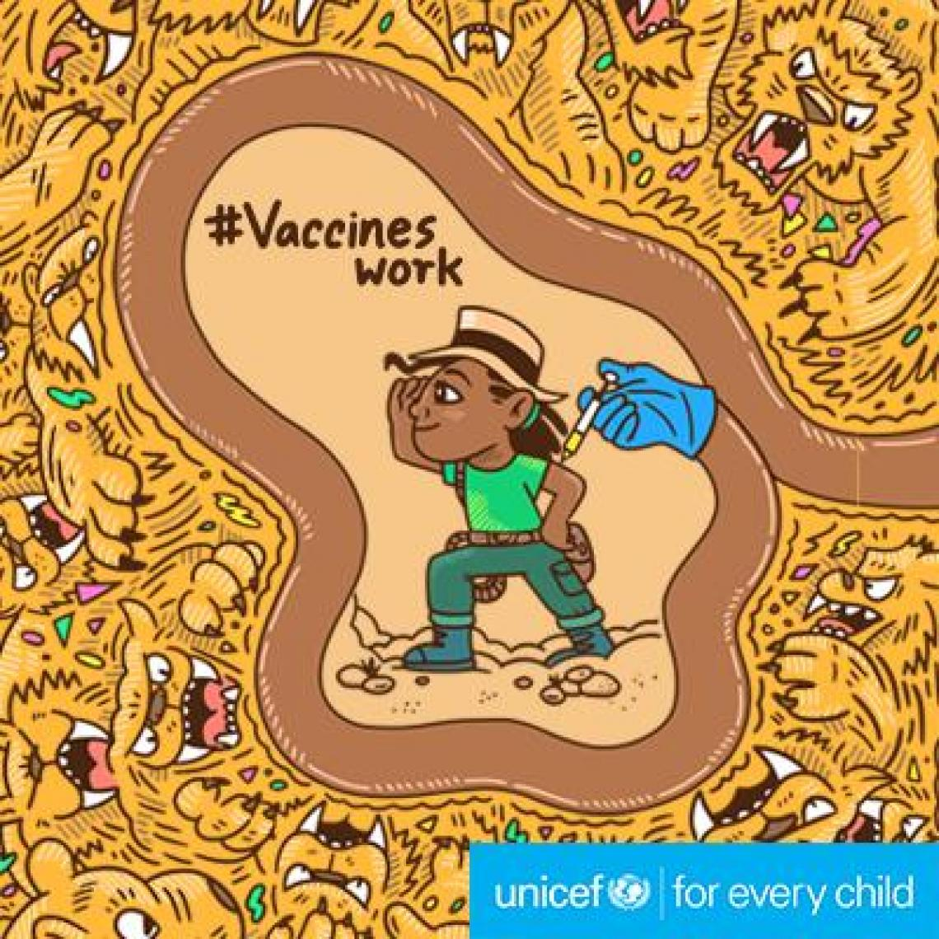
Five Important Reasons to Vaccinate Your Child
Immunizations can save your child’s life.
Vaccination is very safe and effective.
Immunization protects others you care about.
Immunizations can save your family time and money.
Immunization protects future generations.

Slide 5
Objective of this project :
Develop a children vaccination system
Add children’s information
Search children’s information
Update vaccine number & age
Delete children’s information
To develop a basic software which will help the health worker to ensure the most satisfying service to the children’s parents.

Slide 6
Features of the software:
1. Adding children’s records.
2. Showing Records.
3. Update Information.
4. Deleting children records.

Slide 7
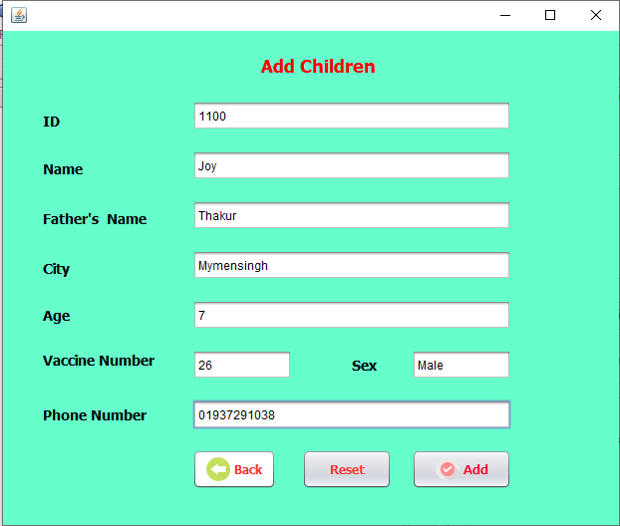
Add Children:
In this section we are storing a new born baby’s information or a child who’s family has changed their previous home and come to a new home.

Slide 8
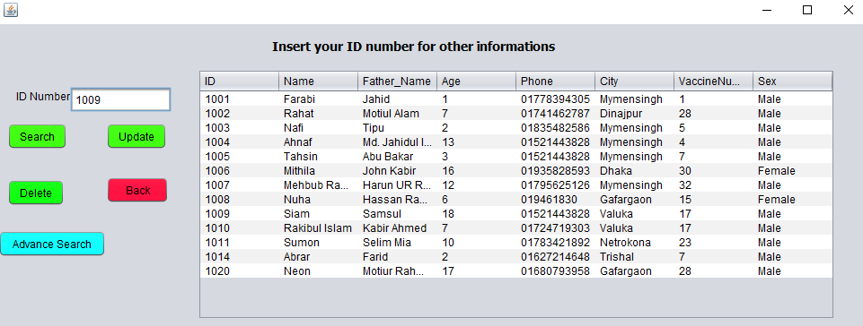
Searching Children :
We can search children through their ID .By using ID we can search a particular child information.

Slide 9
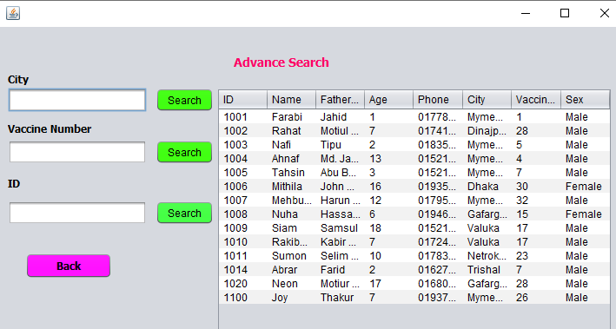
Advance Search :
We can also search particular information by the city & by the vaccine number.

Slide 10
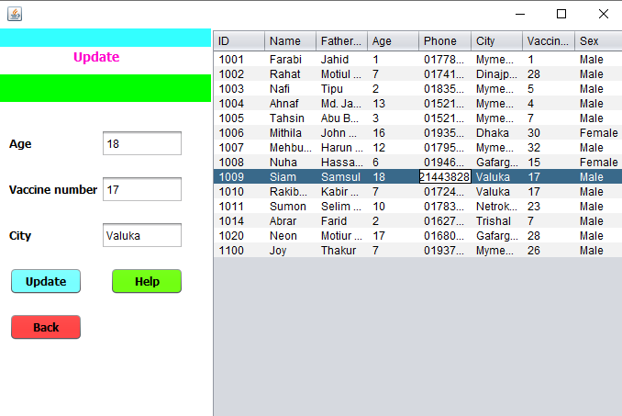
Update Information :
We can search information through their ID then we can update their age & vaccine number .

Slide 11
Delete :
We can delete a tuple information through a child’s ID.

Slide 12
Limitation:
Our system do not include date.
We cannot store previous vaccine data .
This can done only a health worker’s work.

Slide 13
Future works
As we said in the previous slide that we cannot store previous data or find out which date of vaccine is being injected . But we hope in future time we will be solve this problem and make this children vaccination System more efficient and useful.

Slide 14
Conclusion
Our contributions are on-
Provide digital platform for vaccination system.
Data error reduced.
More efficient.

Slide 15
References :
Five Important Reasons to Vaccinate Your Child , ( U.S. Department of Health & Human Services ) https://www.vaccines.gov/getting/for_parents/five_reasons .
Health topics vaccines, https://www.who.int/southeastasia.
https://www.who.int/data/gho.
Global Health Observatory data , Explore a world of health data, Bangladesh https://www.who.int/data/gho/data/countries/country-details/GHO/bangladesh?countryProfileId=f4f4d019-157e-4c15-b9f0-8f67f79a44fc.
Challenging our perspectives on vaccination, https://www.weforum.org/agenda/2019/04/vaccines-work-vaccinations-healthcare-medicine-world-immunization-week-health-organization/
Levels and trends in child mortality report 2019(Authors: UNICEF, WHO, World Bank, UN-DESA Population Division),https://www.who.int/maternal_child_adolescent/documents/levels_trends_child_mortality_2019/en/
Health Bulletin, 2018 ,https://dghs.gov.bd/index.php/bd/
Vaccinate Your Baby for Best Protection https://www.cdc.gov/features/infantimmunization/index.html

Slide 16

Acknowledgements
We are grateful to :
Prof. Dr. A H M Kamal, Supervisor of this project
Our parents
Our teachers of CSE, JKKNIU and
Department of CSE, JKKNIU

Slide 17
Acknowledgements
This project is based on WHO informations & health data.
Thanks Ministry of Health and Family Welfare, Government of the People's Republic of Bangladesh for giving public access data .
Thanks U.S. Department of Health & Human Services for five Important Reasons to Vaccinate Your Child information.

Slide 18
THE END
Thanks.
Any question?

